Slide 1


Day 09
contact@anubhavtrainings.com
ABAP RESTFUL APPLICATION PROGRAMMING

Slide 2

Agenda – Day 09
Service Consumption Model
Describing the Concept of Custom Entity
Why we use Custom Entity
Implement Custom Entity
Create Class for Custom Entity
Test Custom Entity
Working with Attachment Functionality
Build Table for attachments
Implement CDS Entities and projection
Make behaviour Definition
Create Service definition
Build Fiori App for Attachment

Slide 3
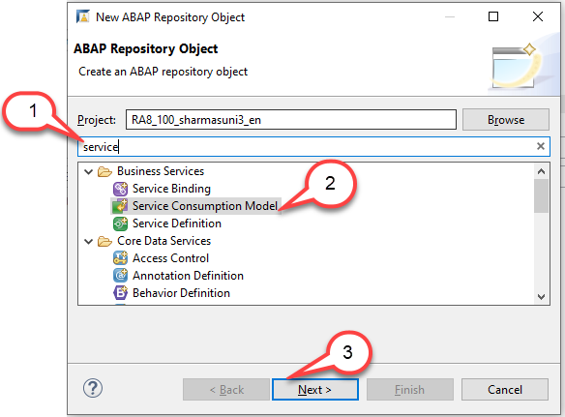
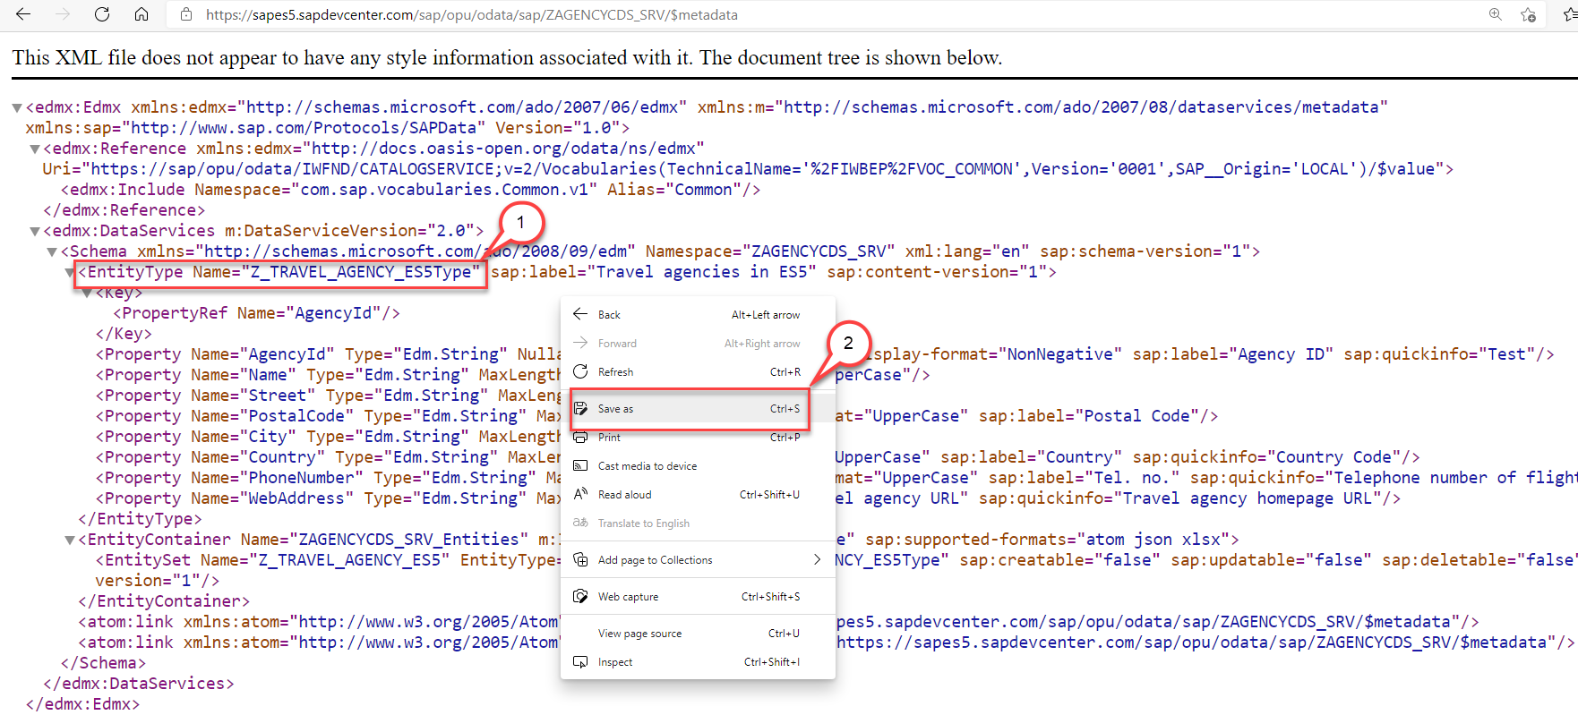
Creating the Service Consumption Model
Create an OData service consumption model in an SAP Business Technology Platform, ABAP Environment instance. In a second instance, prepare it for consumption.
Step1: Download $metadata file https://sapes5.sapdevcenter.com/sap/opu/odata/sap/ZAGENCYCDS_SRV/$metadata
Step2: Create the Service Consumption Model

Slide 4
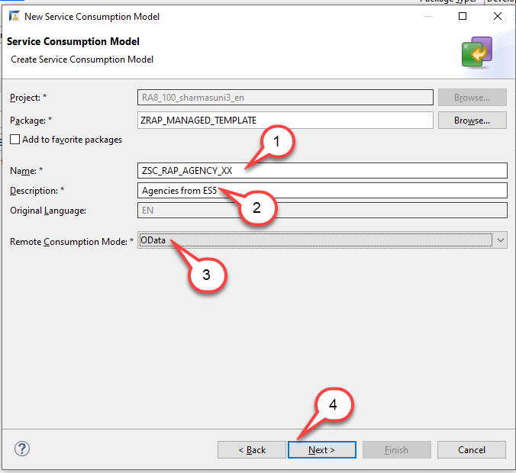
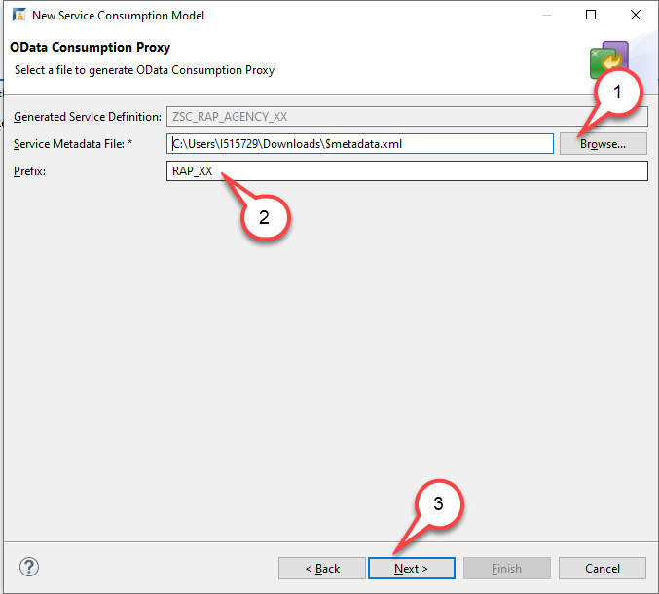
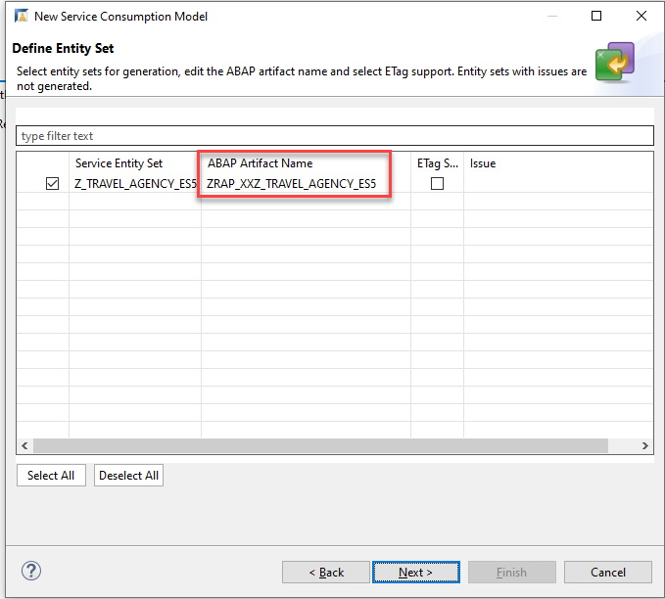
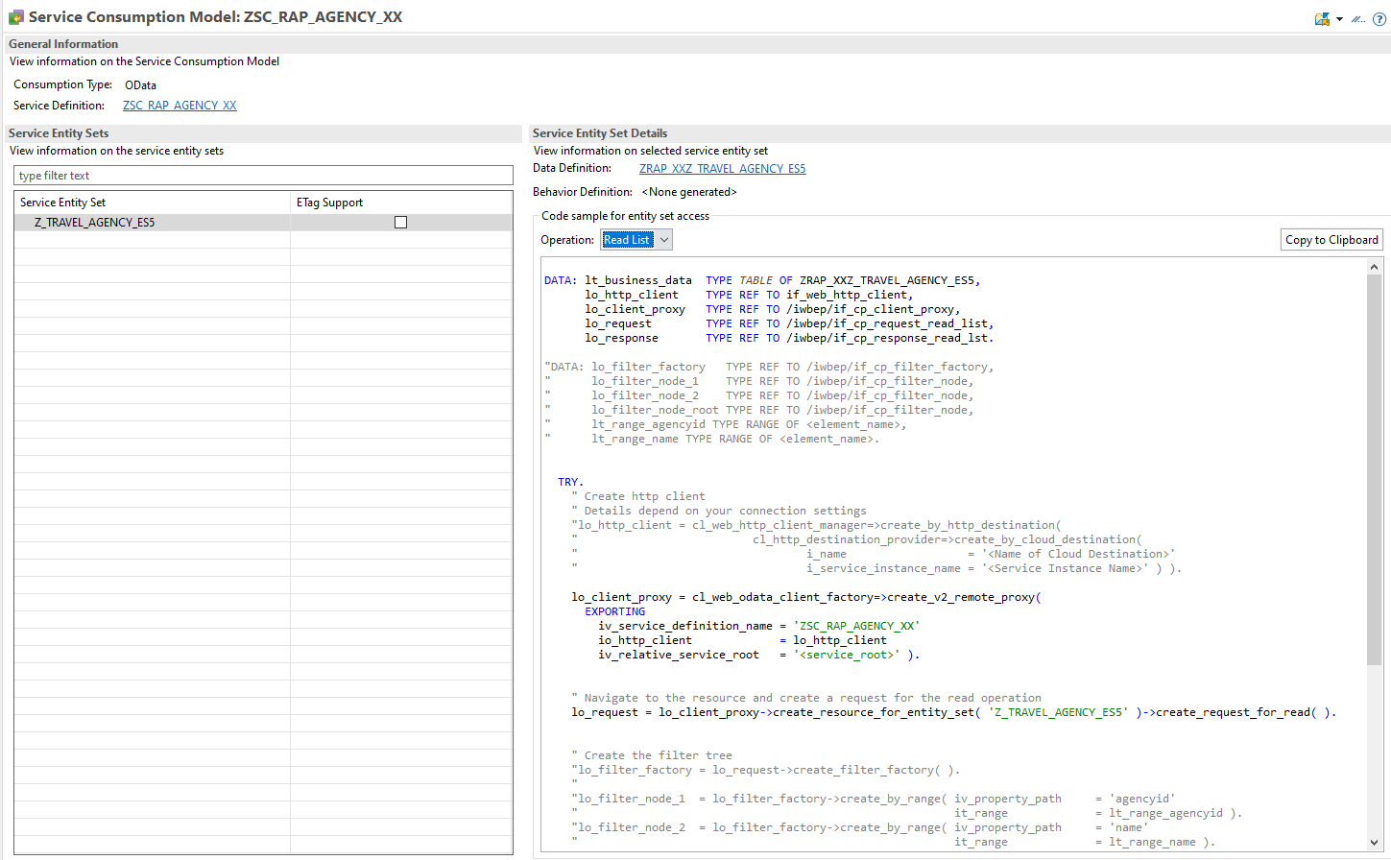
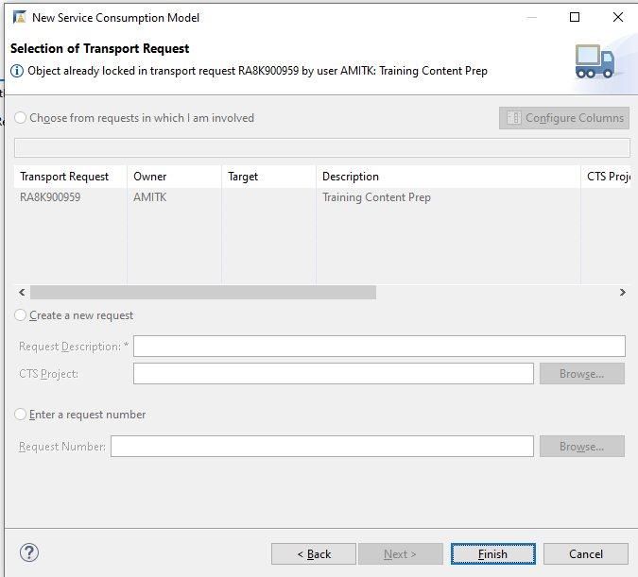
Creating the Service Consumption Model
Steps for Creating Service Consumption Model Click Next to Each step and finish.
For each operation (Read List, Read, Create, Update and Delete) some sample code has been created that you can use when you want to call the OData Service with one of these operations. Since we want to retrieve a list of Agencies, we will select the operation Read List and use this code.

Slide 5
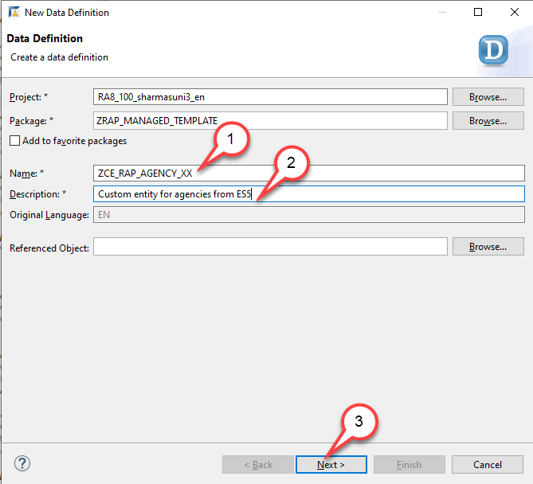
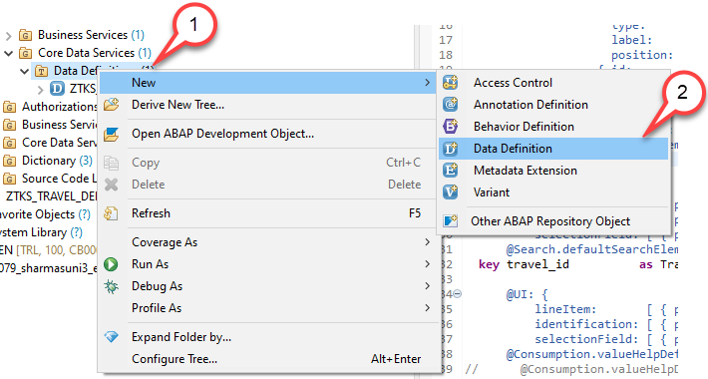
Defining the Custom CDS Entity
The custom entity must be created manually with similar syntax as the abstract entity that has been created when we have created our service consumption model. To leverage the remote OData service in our application we have thus to perform two steps: o We must create a custom entity. o We must create a class that implements the query for the custom entity. Create a custom entity
1. Right-click on the folder Data Definition and select New Data Definition.
2. Start with creating a new data definition ZCE_RAP_AGENCY_XX using the template for a Custom Entity.
The New Data Definition dialogue opens…

Slide 6
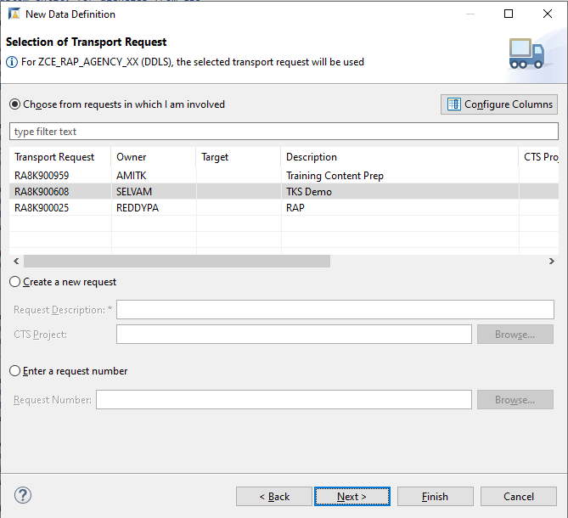
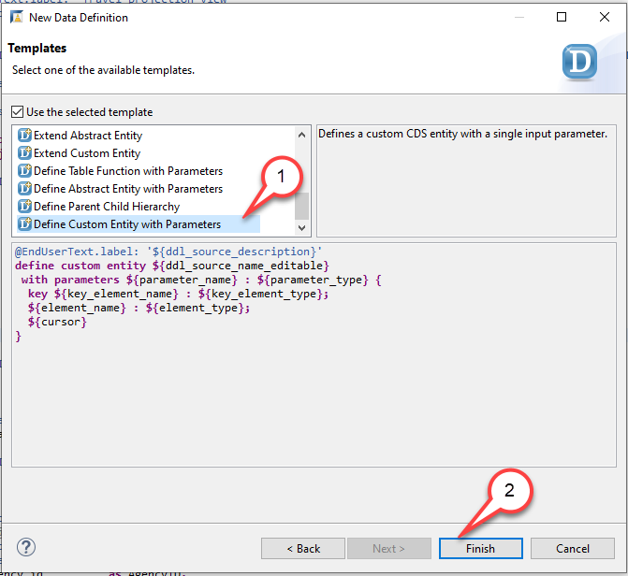
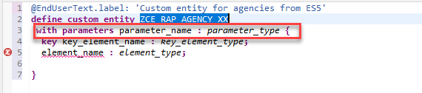
Creating Custom Entity
Press Next. Do NOT press Finish. Caution If you would press Finish instead of Next the wizard will use the template that was used the last time when this wizard was used by the developer.
4. Select the template Define Custom Entity with Parameters. Press Finish…
5. Edit the source code of the custom entity ZCE_RAP_AGENCY_XX Remove the statement with parameters parameter_name : parameter_type

Slide 7
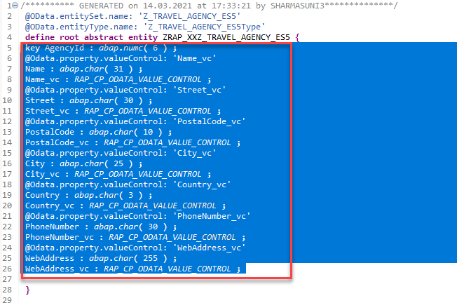
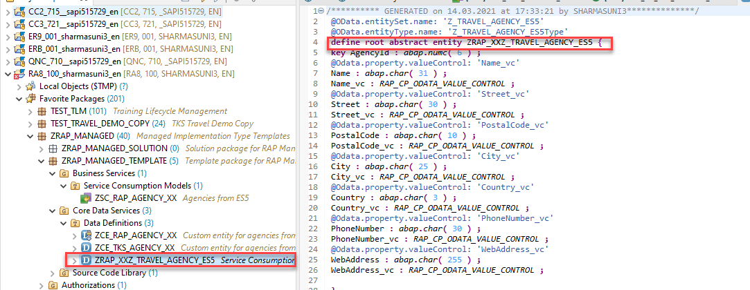
Creating Custom Entity
6. Now, open the abstract entity you created in Service Consumption Model in the source code editor Navigate to the abstract entity ZRAP_XXZ_TRAVEL_AGENCY_ES5 in the Project Explorer Double click on it to open the source code editor
7. Copy field list from abstract entity to custom entity Copy the field list from the abstract entity and paste it between the curly brackets as the new field list of the custom entity, thereby replacing the field list provided by the code template. You can make use of the Source Code Formatter (SHIFT+F1) to format the source code.

Slide 8
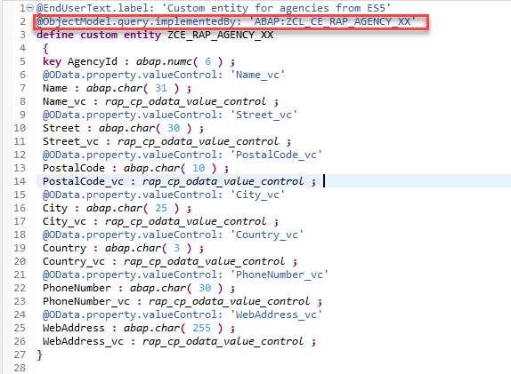
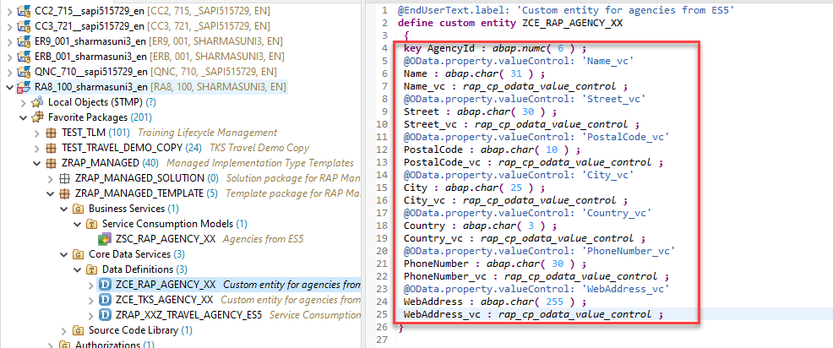
Creating Custom Entity
8.Paste the code in our Custom Entity
9. Add the annotation @ObjectModel.Query.ImplementedBy
to the DDL source code @ObjectModel.query.implementedBy: 'ABAP:ZCL_CE_RAP_AGENCY_XX' and activate your changes.

Slide 9
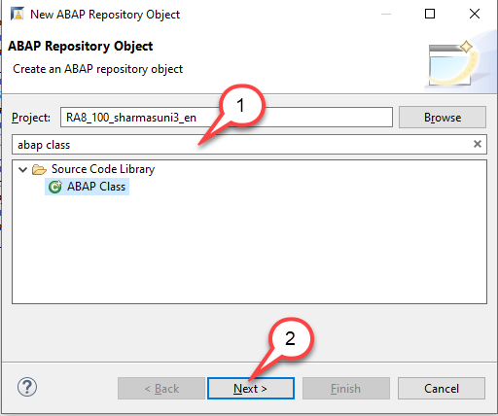
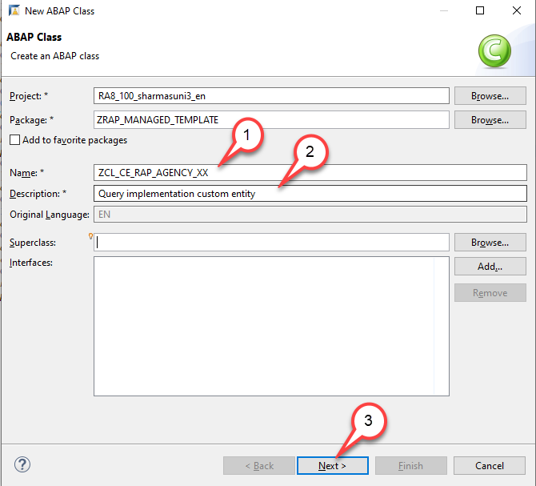
Create a class that implements the query for the custom entity
To be able to use our class as a query implementation class of our custom entity our class must implement the interface if_rap_query_provider. We will thus add this interface to it.
1.Search for ABAP class and press Next
2.Create a new ABAP class ZCL_CE_RAP_AGENCY_XX for custom entity ZCE_RAP_AGENCY_XX. The New Data Definition dialogue opens

Slide 10
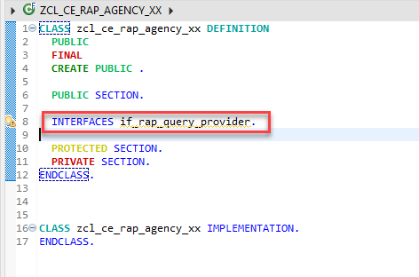
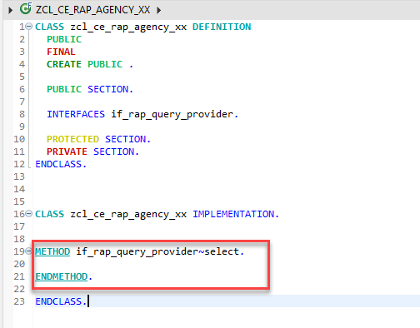
Class Implementation
3. Add interface IF_RAP_QUERY_PROVIDER to the query implementation class ZCL_CE_RAP_AGENCY_XX Add the following statement in the public section INTERFACES if_rap_query_provider.
4. Add an implementation for the method if_rap_query_provider~select.
Code here for Method

Slide 11
Something Important
Implement the method if_rap_query_provider~select. Within the select() method, we can retrieve the details of the incoming OData call using the object io_request. Using the method get_paging() we can find out whether client side paging was requested with the incoming OData call. Using the method get_filter() we can retrieve the filter that was used by the incoming OData request and by calling the method ->get_as_ranges( ) provided by the filter object we can retrieve the filter as ranges. Using the methods is_data_requested( ) and is_total_numb_of_rec_requested( ) we are able to find out whether the incoming request requests that business data is returned and whether the request contains a $count.
Please note:
If business data is requested, It is mandatory to add the retrieved data via the method set_data() .
If in addition, the number of all entries of an entity is requested, the number of entities being returned must be set via the method set_total_number_of_records(). Copy and paste the coding below into the implementation of the method if_rap_query_provider~select.

Slide 12
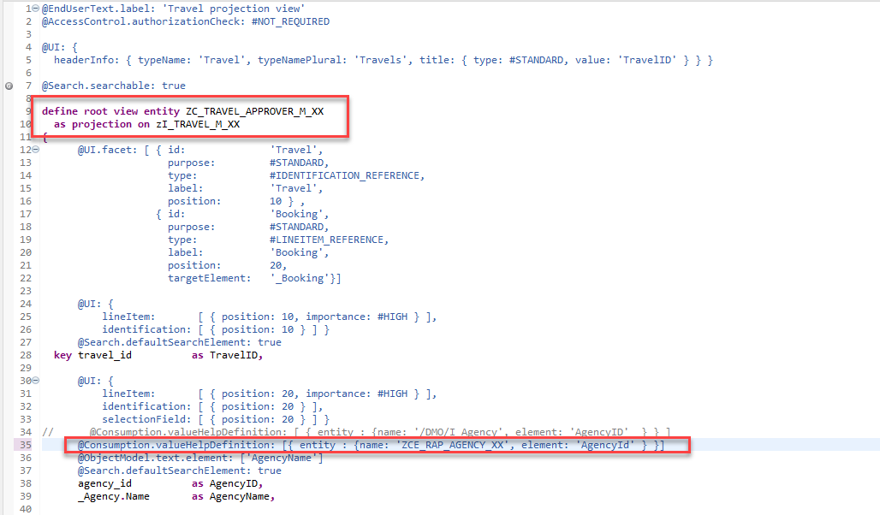
Test the Custom Entity in Projection CDS
You have implemented the query implementation class of the custom entity. As a result we can now enhance the implementation of our managed business object that we have created to use the custom entity as a value help Enhance the manage BO entity

Slide 13
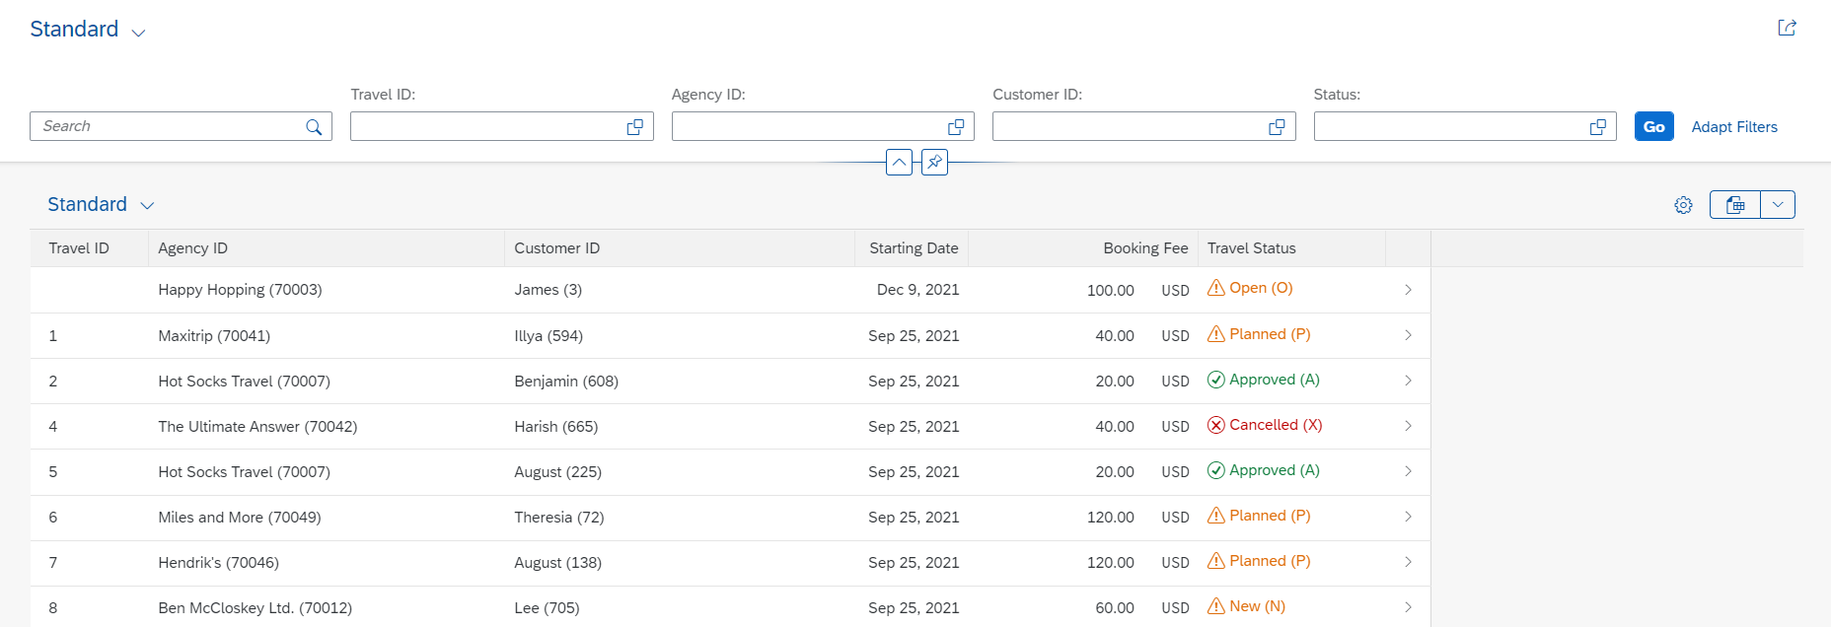
Enabling Status with Icon
A Status with icon provide more intuitive analysis of the data to the business user, using the criticality annotation available at the LineItem level, we can design and deliver best in class user experience with RAP and CDS entities.
Exercise - Solution

Slide 14
Working with LOBs
Uploading Large Object and media such as Excel or Image through your application is a common business requirement and the only way to do it through a RAP application was by extending the application and using UI5 tooling to upload the file.
With the latest SAP BTP ABAP 2208 release the RAP framework now supports OData streams. It is now possible to enable your RAP application to maintain and handle Large Objects(LOBs).This feature provides end users an option to upload external files of different file formats such as PDF, XLSX , binary file format and other types hence allowing media handling.
In this session, we will explore how to upload and handle Large Object such as PDF or Binary files without the need to extend the RAP application in BAS.

Slide 15
LOB’s
Large objects are modeled by means of the following fields:
Attachment
Mimetype
Filename
The field Attachment contains the LOB itself in a RAWSTRING format and is technically bound to the field Mimetype and Filename using semantics annotation.
Mimetype represents the content type of the attachment uploaded and the values for the fields Mimetype and Filename are derived from the field Attachment by the RAP framework based on the maintained CDS annotations. No attachment can exist without its mimetype and vice versa.
For example, when a PDF is uploaded the Mimetype field will be derived and populated with ‘APPLICATION/PDF’.

Slide 16
Create DB Model for Attachment
A Database table was built as per code snippet below.
The field attachment has a data type of RAWSTRING. In BTP ABAP environment you cannot use RAWSTRING domain directly so create a custom domain with data type as RAWSTRING and Length as ‘0’ . This is important as length being ‘0’ would indicate that the RAWSTRING has No length restriction and can accommodate file of larger size. ZMIMETYPE and ZFILENAME are both of type Character and length 128.
Invoice Header
1..*
Invoice Attachments

Slide 17






















Slide 18


















Slide 19
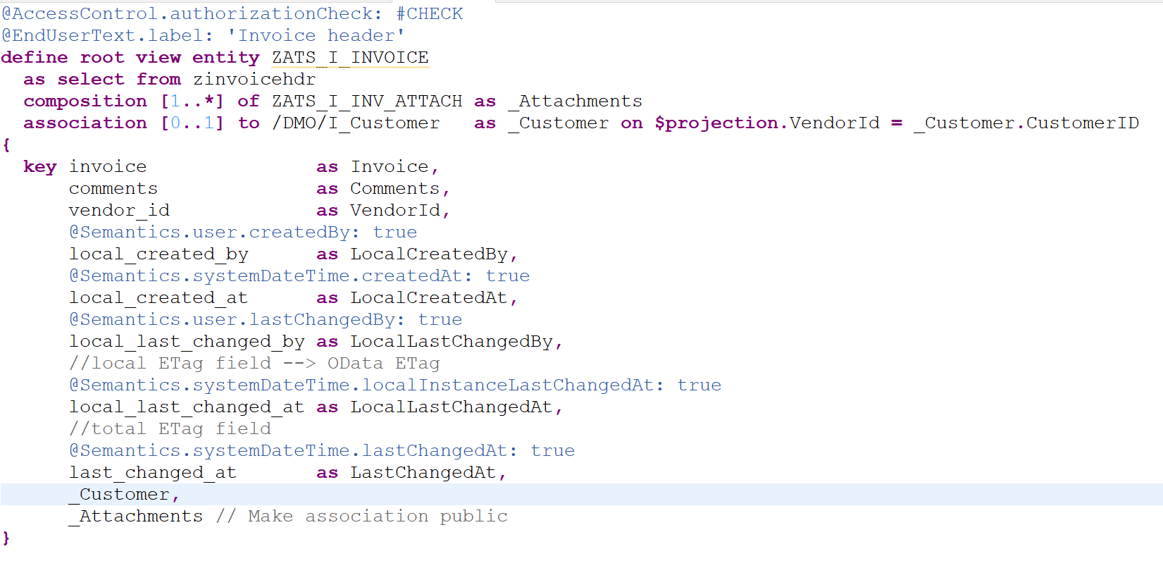
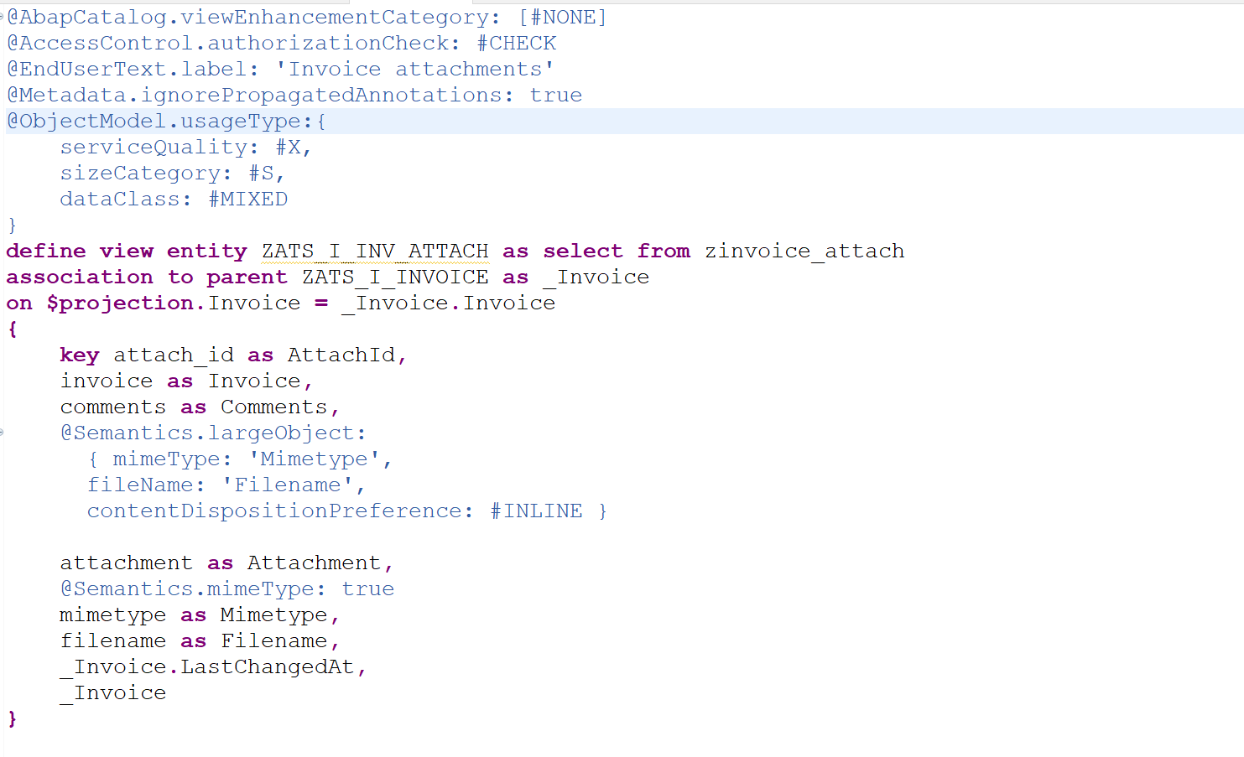
Design CDS entities
CDS annotation @Semantics.largeObject technically binds the MimeType and Filename to the Attachment.
The annotation contentDispositionPreference can be used to define whether, depending on the browser settings, the file attachment is either displayed in the browser (setting #INLINE) or downloaded when selected (option #ATTACHMENT).
Annotation @Semantics.largeObject.acceptableMimeTypes can be used to restrict the Media types which can be uploaded. The validation and Error handling on upload of unsupported media type is handled by the RAP framework.
CDS annotation @Semantics.mimeType: true was used to define the field MimeType as such.

Slide 20
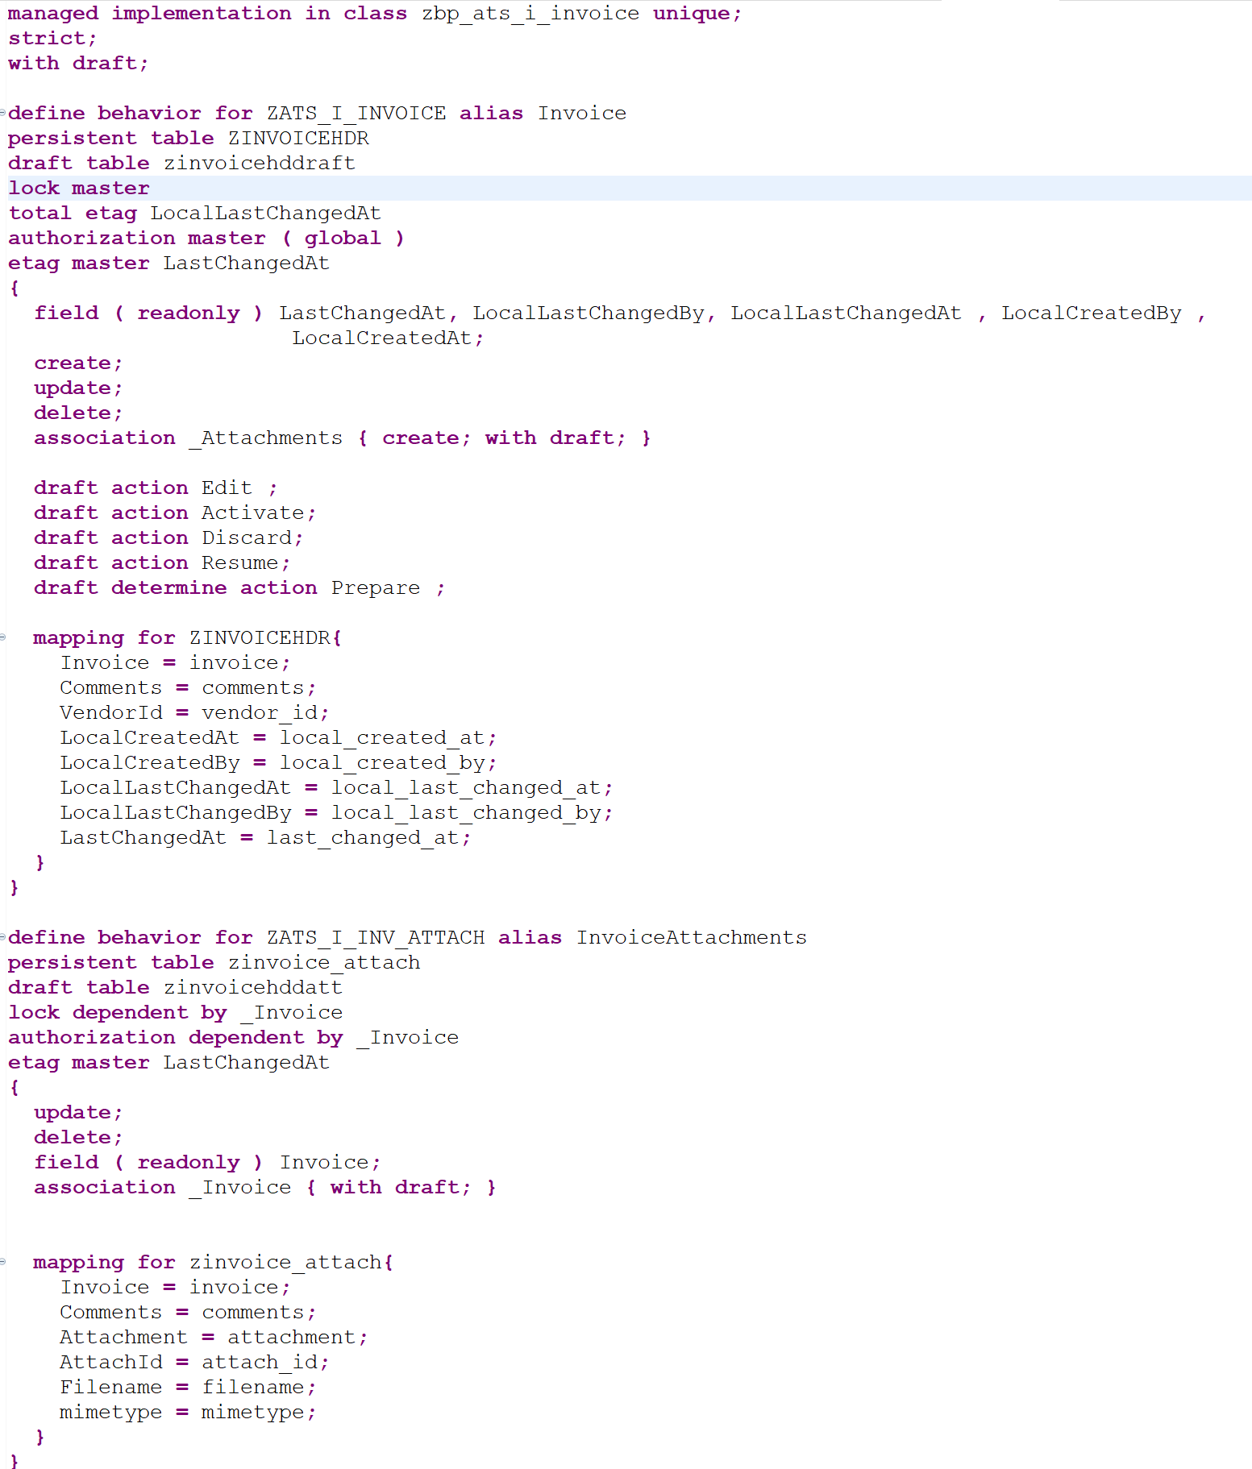
Define Behavior Definition with Draft

Slide 21
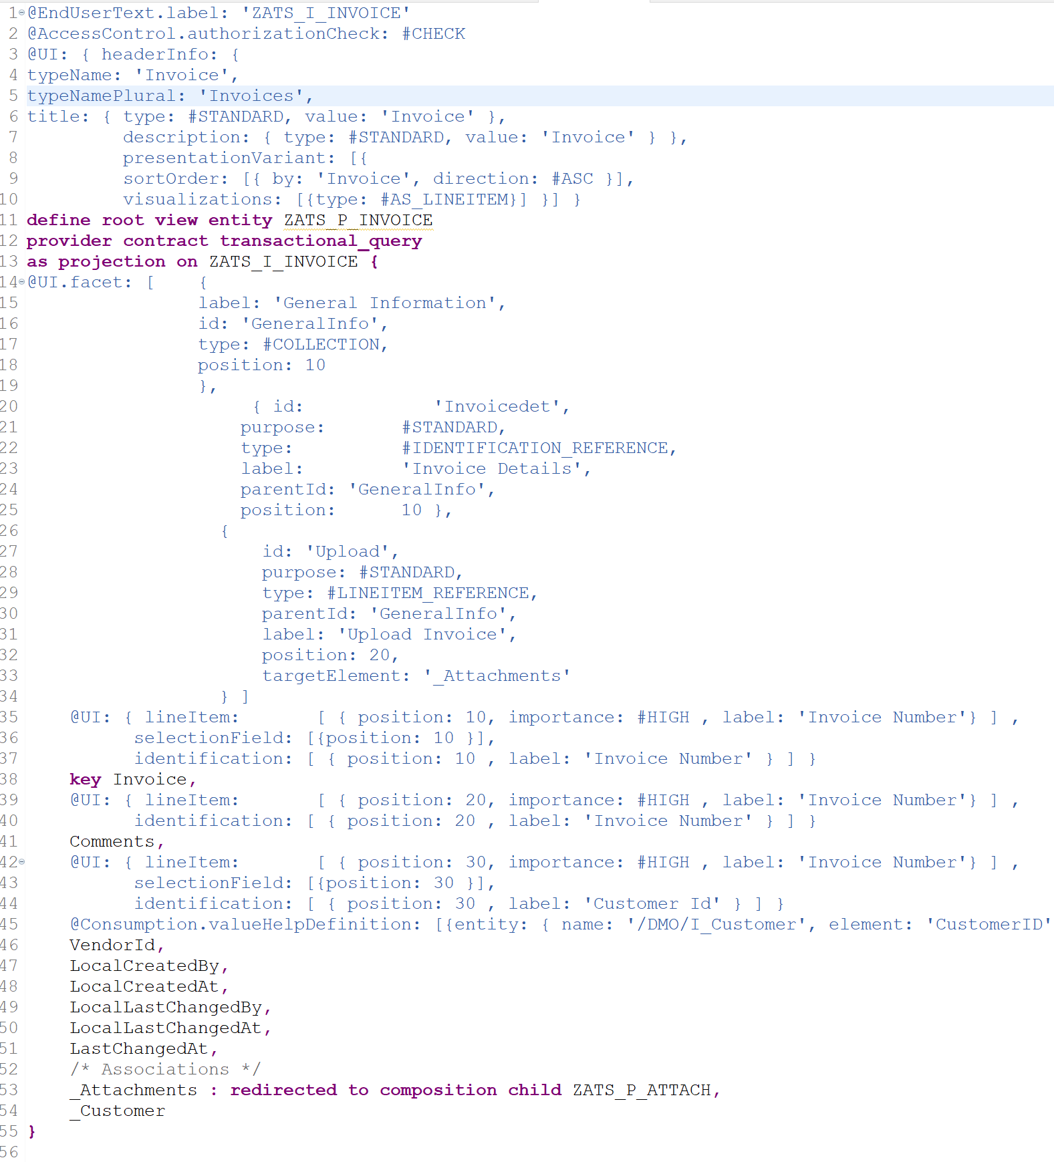
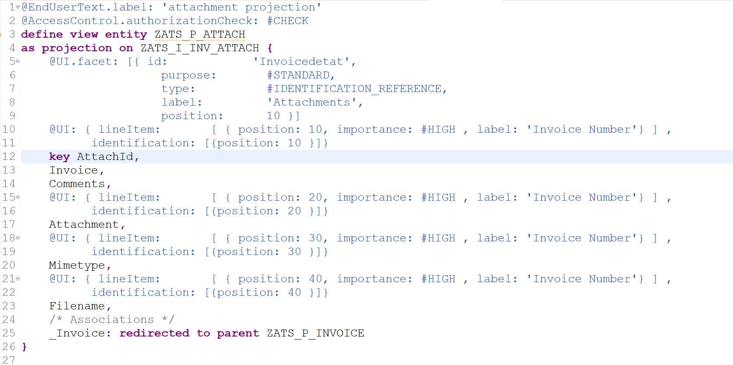
CDS projection and UI Annotations

Slide 22
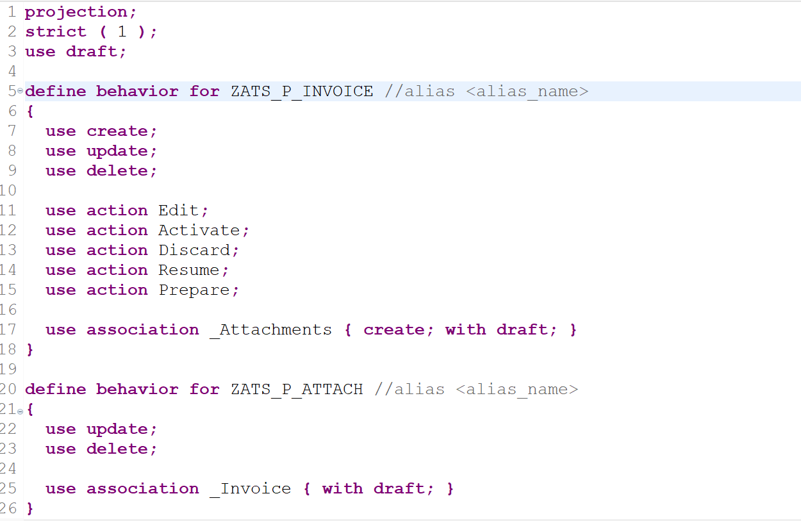
Behavior Definition on projection

Slide 23
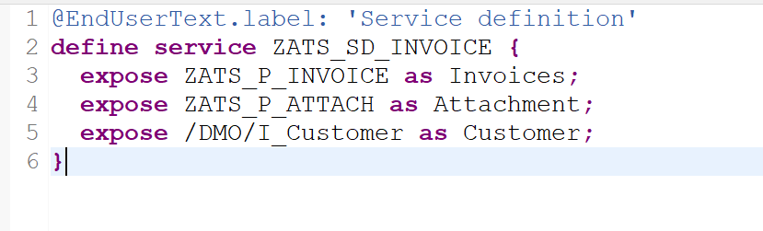
Service Definition
Note: The create operation on V4 Odata is only available if we add draft functionality.
Create Odata V4 Service implementation.

Slide 24
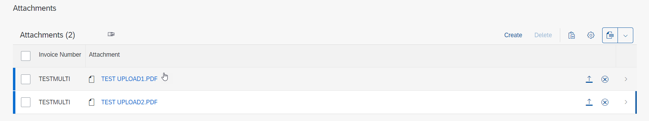
Fiori App with multiple Attachments
Text

Slide 25
Title
Text

Slide 26
Title
Text

Slide 27
Title
Text

Slide 28

End of Day 09
Trainer: Anubhav Oberoy

Slide 29
Trainer: Anubhav Oberoy

Slide 30
THANK YOU
If you cannot do
great things, do small things in a great way.
Anubhav Oberoy
https://www.anubhavtrainings.com

Slide 31


We’re committed to empower you to be
Most Desirable Resource
through powerful training solutions.
We build the workforce of the future.
250+
Corporate Clients
30,000+
Learners Trained
25000+
Learners Placed
FREE WEBINARS
Sign up for free webinars with industry experts every fortnight!
Enroll Now!
Contact us today!
https://anubhavtrainings.com/

Slide 32




More from AnubhavTrainings.com

